Slide 1
SQL Case Study on IPL Dataset
Deepak Chawde

Slide 2
Information :
This dataset of IPL is of year three years
The analysis of this questions are give proper insight of the data
There are two sheets in the excel file
Deliveries
Matches
Agenda is to find the business insight form the dataset

Slide 3
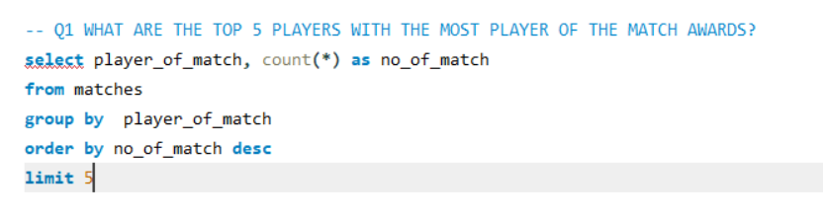
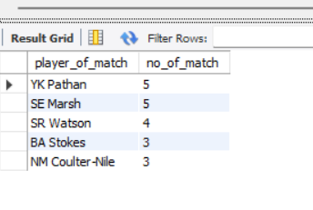
Q1 WHAT ARE THE TOP 5 PLAYERS WITH THE MOST PLAYER OF THE MATCH AWARDS?

Slide 4
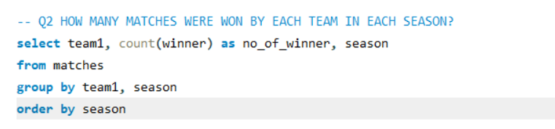
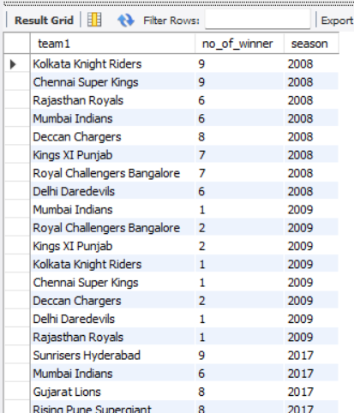
Q2 HOW MANY MATCHES WERE WON BY EACH TEAM IN EACH SEASON?

Slide 5
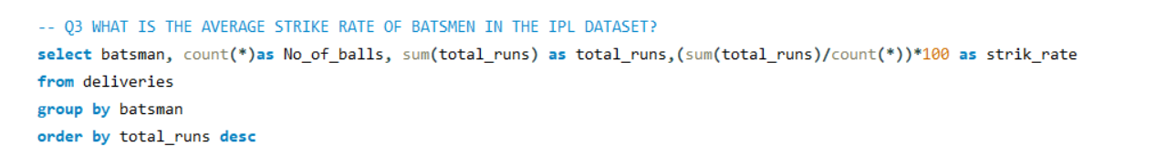
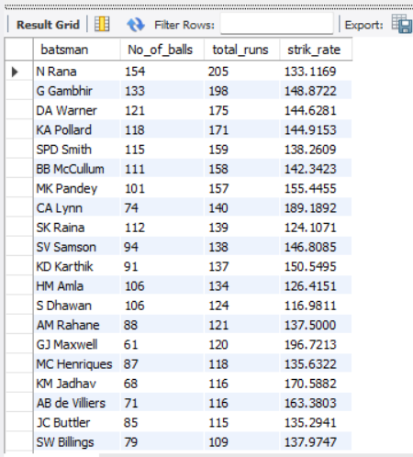
Q3 WHAT IS THE AVERAGE STRIKE RATE OF BATSMEN IN THE IPL DATASET?

Slide 6
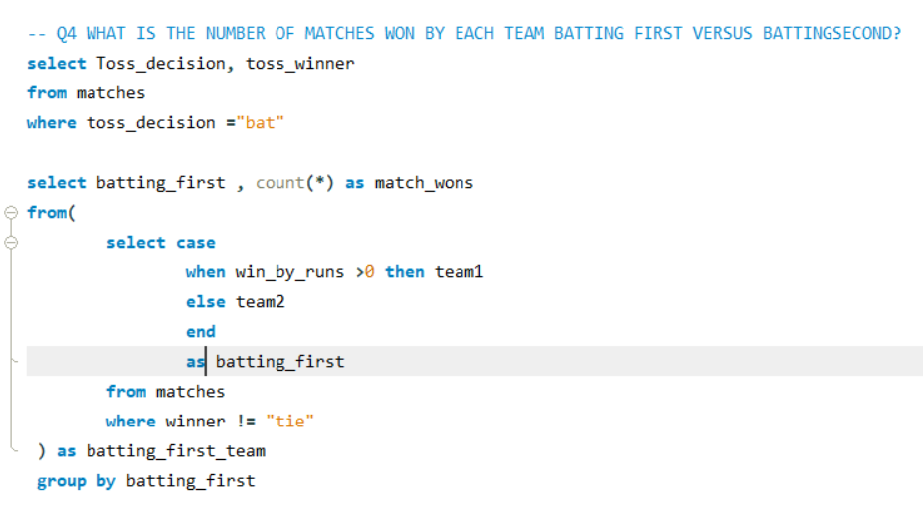
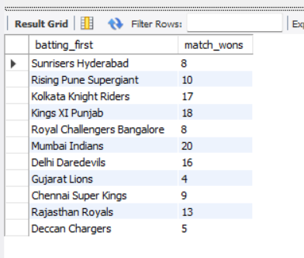
Q4 WHAT IS THE NUMBER OF MATCHES WON BY EACH TEAM BATTING FIRST VERSUS BATTINGSECOND?

Slide 7
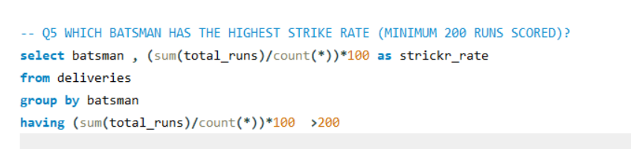
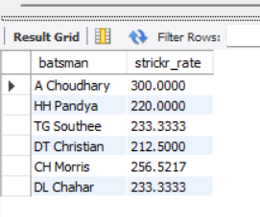
Q5 WHICH BATSMAN HAS THE HIGHEST STRIKE RATE (MINIMUM 200 RUNS SCORED)?

Slide 8
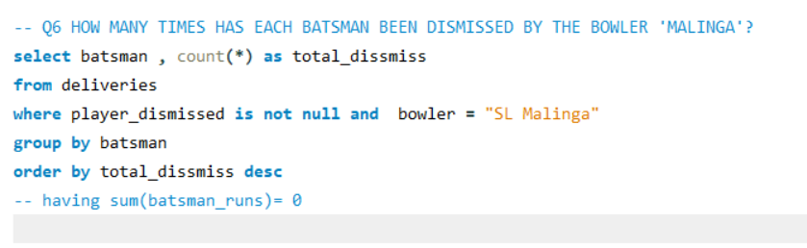
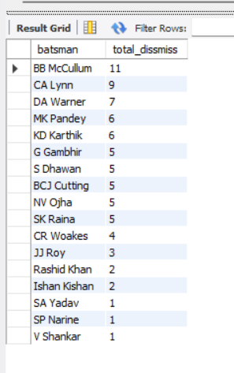
Q6 HOW MANY TIMES HAS EACH BATSMAN BEEN DISMISSED BY THE BOWLER 'MALINGA'?

Slide 9
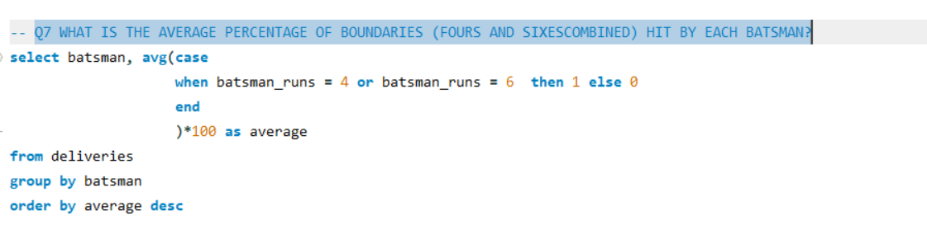
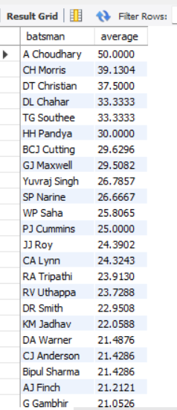
Q7 WHAT IS THE AVERAGE PERCENTAGE OF BOUNDARIES (FOURS AND SIXESCOMBINED) HIT BY EACH BATSMAN?

Slide 10
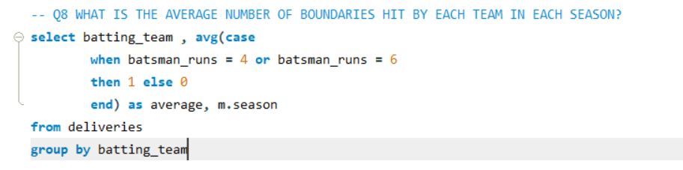
Q8 WHAT IS THE AVERAGE NUMBER OF BOUNDARIES HIT BY EACH TEAM IN EACH SEASON?

Slide 11
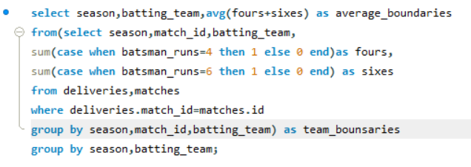
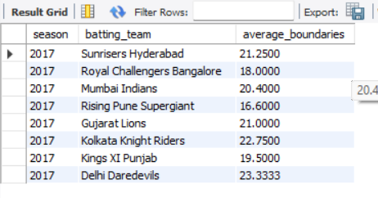
Q8 WHAT IS THE AVERAGE NUMBER OF BOUNDARIES HIT BY EACH TEAM IN EACH SEASON?

Slide 12
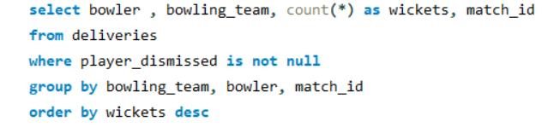
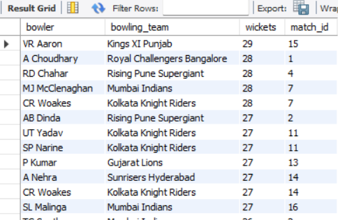
Q9 WHAT IS THE HIGHEST PARTNERSHIP (RUNS) FOR EACH TEAM IN EACH SEASON?

Slide 13
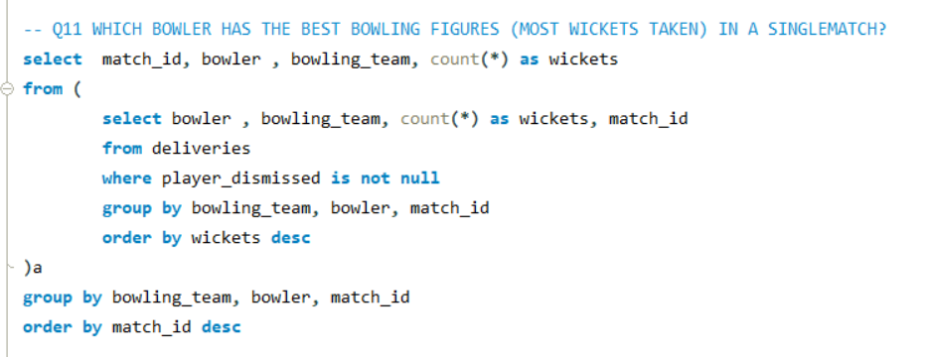
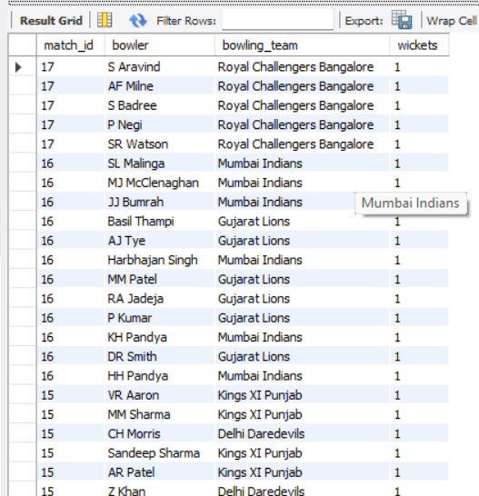
Q11 WHICH BOWLER HAS THE BEST BOWLING FIGURES (MOST WICKETS TAKEN) IN A SINGLEMATCH?

Slide 14
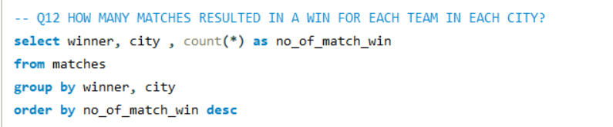
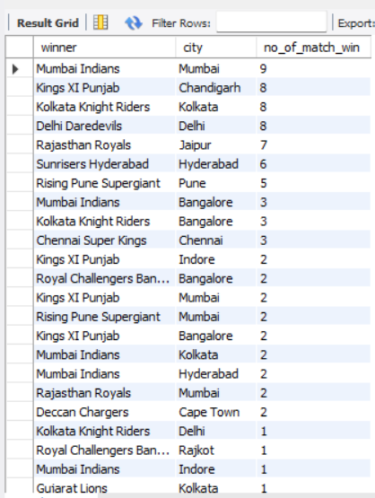
Q12 HOW MANY MATCHES RESULTED IN A WIN FOR EACH TEAM IN EACH CITY?

Slide 15
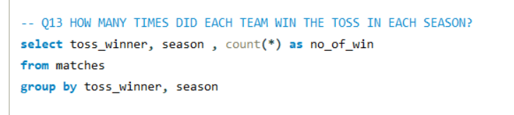
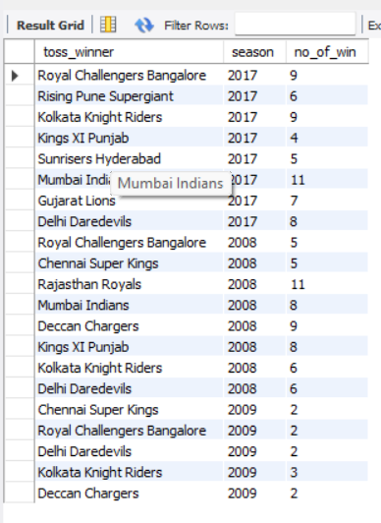
Q13 HOW MANY TIMES DID EACH TEAM WIN THE TOSS IN EACH SEASON?

Slide 16
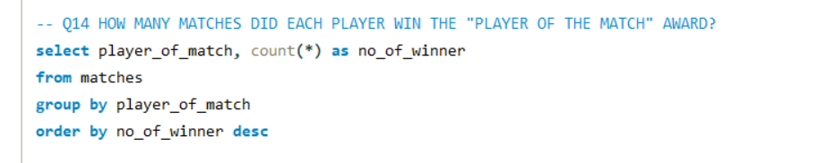
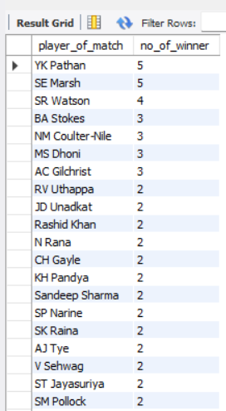
Q14 HOW MANY MATCHES DID EACH PLAYER WIN THE "PLAYER OF THE MATCH" AWARD?

Slide 17
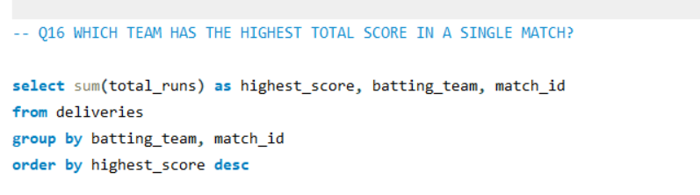
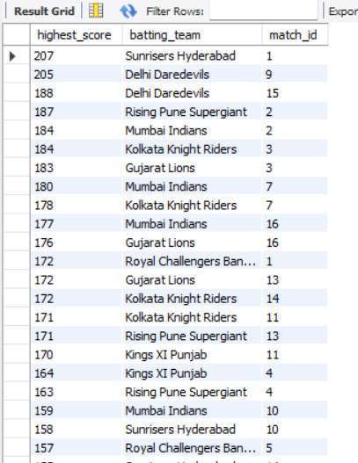
Q16 WHICH TEAM HAS THE HIGHEST TOTAL SCORE IN A SINGLE MATCH?

Slide 18
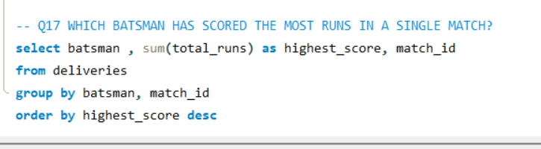
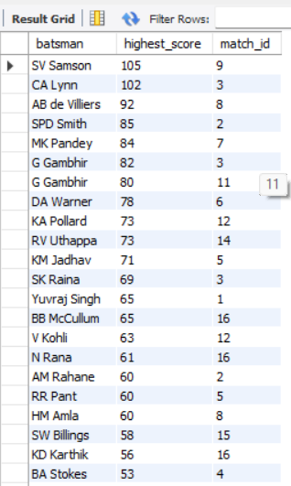
Q17 WHICH BATSMAN HAS SCORED THE MOST RUNS IN A SINGLE MATCH?

Slide 19
THANK YOU

